Slide 1

Unit No 4 Inheritance and Interfaces in Java

Slide 2
Inheritance is one of the cornerstones of object-oriented programming because it allows the creation of hierarchical classifications.
Using inheritance, you can create a general class that defines traits common to a set of related items.
This class can then be inherited by other, more specific classes, each adding those things that are unique to it. In the terminology of Java, a class that is inherited is called a superclass.
The class that does the inheriting is called a subclass. Therefore, a subclass is a specialized version of a superclass.
It inherits all of the instance variables and methods defined by the superclass and adds its own, unique elements.
Inheritance Overview

Slide 3
To minimize the amount of duplicate code in an application
Reusability
Extensibility
Data hiding
Benefits
of
Inheritance

Slide 4
class Parent {
// fields and methods
} class Child extends Parent {
// additional fields and methods
}
Syntax
Note: In Java, inheritance is implemented using the extends keyword.

Slide 5
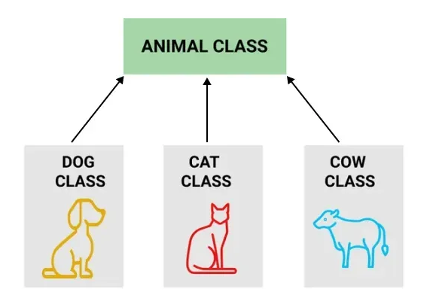

Slide 6
// Parent class
class Animal {
void sound() {
System.out.println("Animal makes a sound");
}
}
​// Child class
class Dog extends Animal {
void sound() {
System.out.println("Dog barks");
}
}
​// Child class
class Cat extends Animal {
void sound() {
System.out.println("Cat meows");
}
}
Example:
In the following example, Animal is the base class and Dog, Cat, and Cow are derived classes that extend the Animal class.
"Continued on next slide."

Slide 7
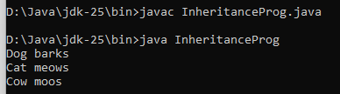
// Child class
class Cow extends Animal {
void sound() {
System.out.println("Cow moos");
}
}
​// Main class
public class InheritanceProg{
public static void main(String[] args) {
Animal a;
a = new Dog();
a.sound();
​
a = new Cat();
a.sound();
​
a = new Cow();
a.sound();
}
}
Continue…
Output

Slide 8
Term | Description
Class | Blueprint from which objects are created
Superclass | Class whose properties are inherited
Subclass | Class that inherits another class
extends | Keyword used to inherit a class
Key Terminologies
in
Java Inheritance

Slide 9
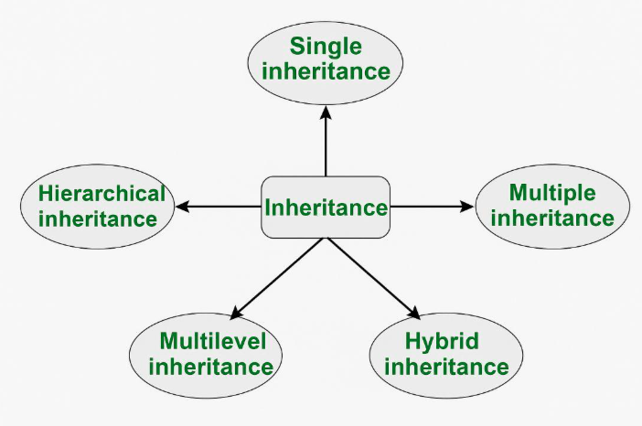
Types of Inheritance in Java

Slide 10
Types of inheritance
in java

Slide 11
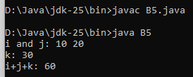
// Create a superclass.
class A {
int i=10, j=20;
void showij() {
System.out.println("i and j: " + i + " " + j);
}
}
// Create a subclass by extending class A.
class B5 extends A {
int k=30;
void showk() {
System.out.println("k: " + k);
}
void sum() {
System.out.println("i+j+k: " + (i+j+k));
}
public static void main(String args [])
{ B5 obj = new B5();
obj.showij();
obj.showk();
obj.sum();
}
}
Example No 1

Slide 12
// Create a superclass.
class A {
int i=10, j=20;
void showij() {
System.out.println("i and j: " + i + " " + j);
}
}
// Create a subclass by extending class A.
class B6 extends A {
int k=30;
void showk() {
System.out.println("k: " + k);
}
void sum() {
System.out.println("i+j+k: " + (i+j+k));
}
}
class SimpleInheritance {
public static void main(String args[]) {
A superOb = new A();
B subOb = new B();
// The superclass may be used by itself.
superOb.i = 10;
superOb.j = 20;
System.out.println("Contents of superOb: ");
superOb.showij();
/* The subclass has access to all public members of its superclass*/
subOb.i = 7;
subOb.j = 8;
subOb.k = 9;
System.out.println("Contents of subOb: ");
subOb.showij();
subOb.showk();
System.out.println("Sum of i, j and k in subOb:");
subOb.sum();
}
}
Example No 2
Question:- What will be the output for given program….????????

Slide 13
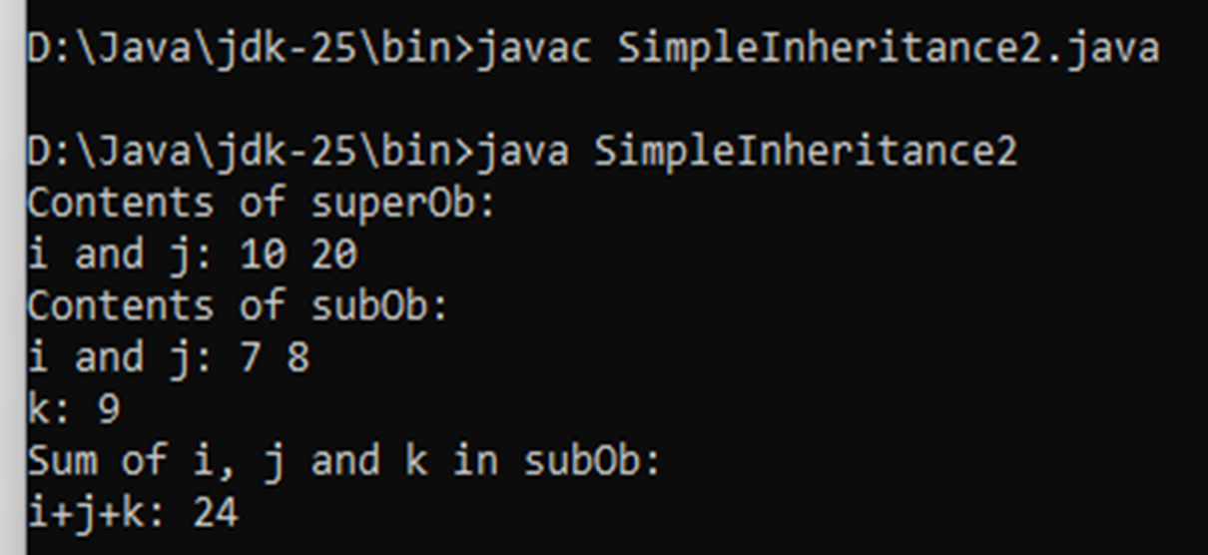
****Output****

Slide 14
class Animal{
void eat()
{System.out.println("eating...");
}
}
class Dog extends Animal{
void bark()
{System.out.println("barking...");
}
}
class TestInheritance{
public static void main(String args[ ])
{ Dog d=new Dog();
d.bark();
d.eat();
}
}
Output:
barking...
eating...
Example No 2

Slide 15
Inheritance
In
constructor
In Java, constructor inheritance is not done directly because constructors are not inherited
like methods.
However, a subclass can call a superclass constructor using the super()
keyword to initialize the parent class before executing its own constructor.

Slide 16
Key Points:
The super() Call
The first statement in a subclass constructor must be a call to super() if you want to invoke a
specific constructor of the parent class.
If no explicit super() is provided, Java automatically calls the default (no-argument)
constructor of the parent class.
If the parent class has only parameterized constructors, the subclass must explicitly call one
using super(arguments).
Continue…

Slide 17
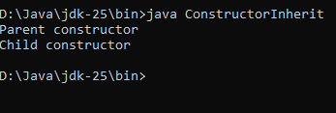
class Parent{
Parent(){
System.out.println("Parent constructor");
}
}
class Child extends Parent{
Child(){
System.out.println("Child constructor");
}
}
public class ConstructorInherit{
public static void main(String[] args) {
Child obj = new Child();
}
}
Output :-
Parent constructor
Child constructor

Slide 18
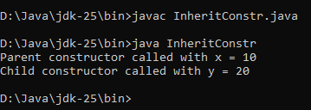
class Parent {
int x;
// Parameterized constructor
Parent(int x) {
this.x = x;
System.out.println("Parent constructor called with x = " + x);
}
}
class Child extends Parent {
int y;
// Child constructor
Child(int x, int y) {
super(x); // Calls Parent constructor
this.y = y;
System.out.println("Child constructor called with y = " + y);
}
}
public class InheritConstr{
public static void main(String [ ] args) {
Child obj = new Child(10, 20);
}
}
Example
Output

Slide 19
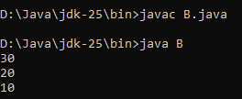
super keyword
//import java.lang.*;
class A {
int a=10;
}
class B extends A
{
int a=20;
void show(int a)
{
System.out.println(a);
System.out.println(this.a);
System.out.println(super.a);
}
public static void main(String args [])
{
B obj = new B();
obj.show(30);
}
}

Slide 20
Using super to Call Parent Method
class Parent {
void show() {
System.out.println("Parent method");
}
}
class Child extends Parent {
@Override
void show() {
super.show(); // Calls Parent's method
System.out.println("Child method");
}
}
public class Main {
public static void main(String[] args) {
Child obj = new Child();
obj.show();
}
}
Output:
Parent method
Child method

Slide 21

Inheriting Data Members
Inheriting Data Members (Fields) : -
Data members (variables) of a superclass can be inherited by the subclass based on their access modifiers:
class A {
int x=10;
}
class B1 extends A{
void show(){
System.out.println(x);
}
public static void main (String args []) {
B1 obj = new B1();
obj.show();
}
}

Slide 22
Continue…
Inheritance in Java allows a subclass to acquire the properties and behaviours (fields and methods) of a parent class.
This promotes code reuse and supports the hierarchical classification of classes.

Slide 23
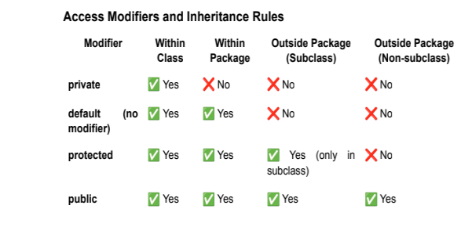

Slide 24
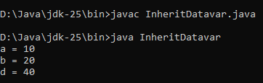
class Parent {
public int a = 10;
protected int b = 20;
private int c = 30; // Not inherited
int d = 40; // Default, inherited within package
}
class Child extends Parent {
void display() {
System.out.println("a = " + a); // Accessible (public)
System.out.println("b = " + b); // Accessible (protected)
// System.out.println("c = " + c); // Not accessible (private)
System.out.println("d = " + d); // Accessible (default, only within the same package)
}
}
public class InheritDatavar {
public static void main(String [ ] args) {
Child obj = new Child();
obj.display();
}
}
Example:
Inheriting Data Members

Slide 25
Inheriting Methods
2. Inheriting Methods :-
Just like data members, methods of a superclass can also be inherited based on their access modifiers.
Method Inheritance Rules
● Public & Protected Methods → Inherited and accessible in the subclass.
● Default Methods → Inherited but accessible only within the same package.
● Private Methods → Not inherited.
● Final Methods → Inherited but cannot be overridden.
● Static Methods → Inherited, but cannot be overridden (they are hidden).

Slide 26

Example: Inheriting and Overriding Methods
class Parent {
void show() {
System.out.println("Parent method");
}
}
class Child extends Parent {
//@Override
void show() { // Overriding the inherited method
System.out.println("Child method" );
}
}
public class MethodOverride {
public static void main(String [ ] args) {
Child obj = new Child();
obj.show(); // Calls the overridden method in Child class
}
} ******Output *********

Slide 27
Multilevel Inheritance in Java
1. Introduction
Multilevel Inheritance is a type of inheritance in Java where a class is derived from another derived class.
In other words, a subclass inherits from a parent class, and then another class inherits from that subclass, forming a chain of inheritance.
2. Key Features
- Allows for the reuse of code across multiple levels.
- Inherited members (fields and methods) pass from one class to another.
- The subclass of a parent class becomes the parent for another subclass.
- Constructors are called in a top-down manner (from parent to child).
- If a method is overridden in an intermediate class, the most recent version is used.

Slide 28
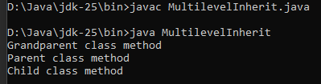
3. Example of Multilevel Inheritance
// Base class (Parent)
class Grandparent {
void displayGrandparent() {
System.out.println("Grandparent class method");
}
}
// Intermediate class (Child of Grandparent)
class Parent extends Grandparent {
void displayParent() {
System.out.println("Parent class method");
}
}
// Derived class (Child of Parent)
class Child extends Parent {
void displayChild() {
System.out.println("Child class method");
} }
public class Main {
public static void main(String[] args) {
Child obj = new Child();
obj.displayGrandparent(); // Inherited from Grandparent
obj.displayParent(); // Inherited from Parent
obj.displayChild(); // Own method
} }
****OutPut****

Slide 29
4. Constructor Execution in Multilevel Inheritance
● In Java, constructors are called from the top of the hierarchy to the bottom.
● If no explicit constructor call is made using super(), Java automatically calls the default constructor of the parent class.

Slide 30
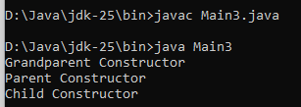
Example of Constructor Execution Order
class Grandparent {
Grandparent() {
System.out.println("Grandparent Constructor");
}
}
class Parent extends Grandparent {
Parent() {
System.out.println("Parent Constructor");
}
}
class Child extends Parent {
Child() {
System.out.println("Child Constructor");
}
}
public class Main {
public static void main(String[] args) {
Child obj = new Child(); // Creating an object of Child
}
}
****OutPut****

Slide 31

5. Method Overriding in Multilevel Inheritance
class Grandparent {
void show() {
System.out.println("Grandparent method");
} }
class Parent extends Grandparent {
@Override
void show() {
System.out.println("Parent method");
} }
class Child extends Parent {
@Override
void show() {
System.out.println("Child method");
}
}
public class Main {
public static void main(String[] args) {
Child obj = new Child();
obj.show(); // Calls the overridden method in Child class
}
}
****OutPut****

Slide 32
Stop Inheritance
* In Java, you can stop inheritance primarily by using the final keyword.
* This can be applied to an entire class to prevent it from being subclassed, or to specific methods to prevent them from being overridden
1. Stopping Class Inheritance
public final class MyClass {
// This class cannot be extended by any other class
}
// This will result in a compilation error:
// class SubClass extends MyClass
{
}
2. Stopping Method Overriding
public class Parent {
public final void criticalMethod() {
// Subclasses can use this method but cannot override it
}
}

Slide 33
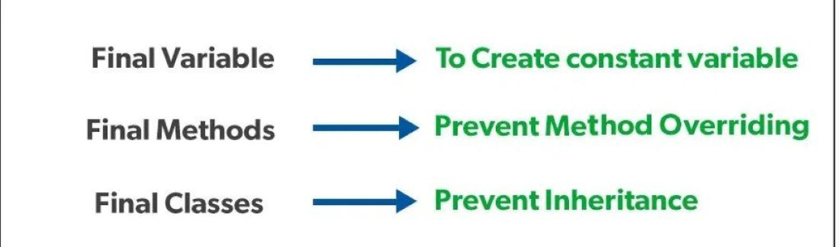
final Keyword in Java
The final keyword is a non-access modifier used to restrict modification. It applies to variables (value cannot change) methods (cannot be overridden) and classes (cannot be extended). It helps create constants, control inheritance and enforce fixed behaviour.
The following are different contexts where the final is used:
Variable
Method
Class

Slide 34
Final Variable
1. Final Variable
A variable declared with final becomes constant after one assignment.
public class Main{
public static void main(String[] args) {
final double PI = 3.14159;
System.out.println("Value of PI: " + PI);
}
}
****Output ******
Value of PI: 3.14159

Slide 35
2. Final Method
When a method is declared with final keyword, it is called a final method in Java. A final method cannot be overridden.
class A
{
final void m1()
{ System.out.println("Final method");
}
} class B extends A {
void m1()
{
} // compile-time error
}

Slide 36
A class declared as final cannot be extended.
3. Final class
A class declared as final cannot be extended.
final class A {
// fields and methods
}
// Illegal
class B extends A
{
} // Error: Cannot inherit from a final class
Final classes are useful when creating immutable classes such as String or wrapper classes.

